Slide 1


Strategic Sales Performance Analysis
Executive Data Review: Superstore Q1 2026 Profitability Optimization & Market Risk Assessment

Slide 2



EXECUTIVE SUMMARY
Growth Highlights
Strategic Risks
Technology remains our primary profit engine, generating over $145,000 in net profit. Profit margins in Office Supplies are strong, driven by high-volume, low-shipping items like Paper and Labels.
Furniture is currently a net drain on resources. Heavy losses in the "Tables" sub-category, particularly in the East Region, are offsetting gains made by our core high-performance divisions.

Slide 3
Product Category Performance
Evaluating the gap between Sales Volume and Net Profitability

Slide 4
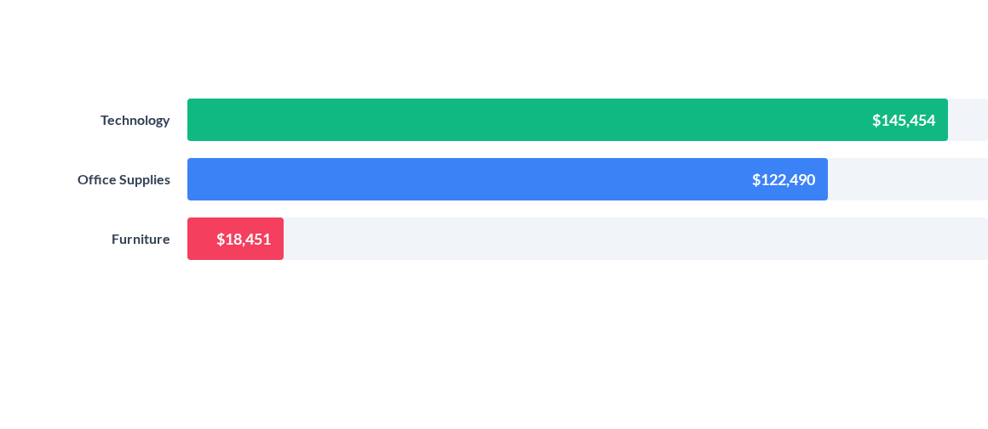
CATEGORY PROFIT RANKING
Technology generates nearly 8x the profit of Furniture, despite having comparable sales volume.

Slide 5


THE FURNITURE PROFITABILITY GAP
Operational Challenges
•
Logistics: Bulky dimensions lead to excessive shipping and storage overheads.
•
Margin Erosion: High average discounts (20%+) are required to move inventory.
•
Table Losses: The "Tables" sub-category alone lost $17,725 globally this quarter.

Slide 6
The "Discount Trap" Analysis
Investigating the inverse relationship between Pricing Strategy and Bottom-line Results

Slide 7


THE DISCOUNT THRESHOLD
Our regression analysis identifies a critical profitability threshold at 20% discount.
Transactions exceeding 25% discount show a 90% probability of a net loss. The "Death Zone" (50%+ discount) accounts for the vast majority of Furniture losses.
Finding: Aggressive discounting does not drive sustainable volume; it drives capital erosion.

Slide 8
Regional Deep-Dive
Isolating Geographical Profit Craters across the Superstore Network

Slide 9
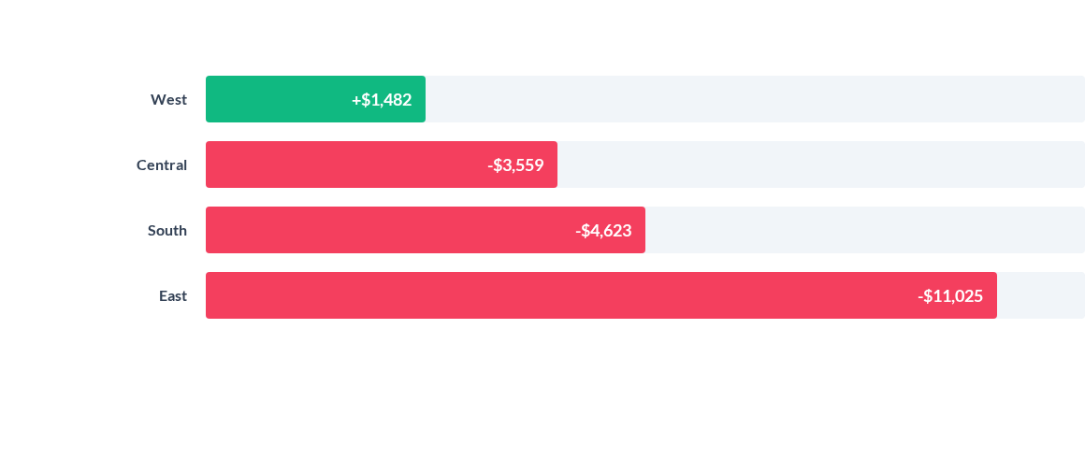
GLOBAL TABLE PROFITS BY REGION
The East Region is responsible for 62% of all global losses in the Table category.

Slide 10
GROUND ZERO: WORST PERFORMING CITIES
Region | City | Sub-Category | Total Profit Loss
East | New York City | Tables | -$3,542.72
East | Philadelphia | Tables | -$2,588.75
East | Lorain | Tables | -$713.43
East | Buffalo | Tables | -$517.03

Slide 11






ACTIONABLE RECOMMENDATIONS
Discount Caps
Logistics Audit
Category Pivot
Implement a 15% system-level cap on Furniture discounts. Any exceptions must undergo managerial approval for ROI validation.
Review East Coast fulfillment partnerships. High urban delivery costs in NYC/Philly are cannibalizing existing margins.
Reallocate 20% of Furniture marketing budget toward high-performing Technology accessories to maximize total Q2 revenue.

Slide 12

Questions?
Analytical review complete. Data sources: Superstore Inventory & Sales Ledger 2026.
PRESENTED BY: FUTURE INTERN - TIDIMATSO MALATJI (Data Analyst)

